Slide 1
欢迎参加 HYPERLEDGER SHANGHAI MEETUP
2017.3.4

Slide 2






Thanks to Our Sponsors

Slide 3
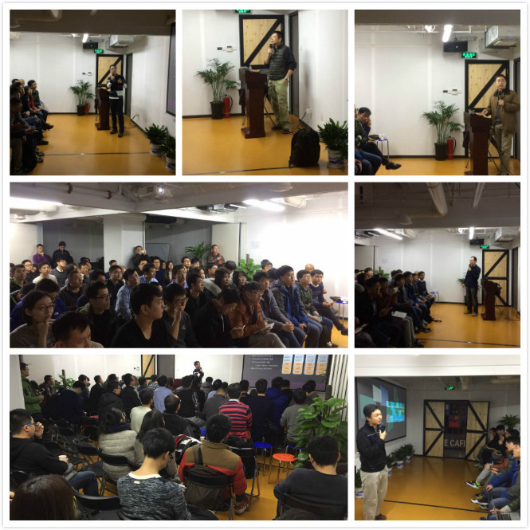
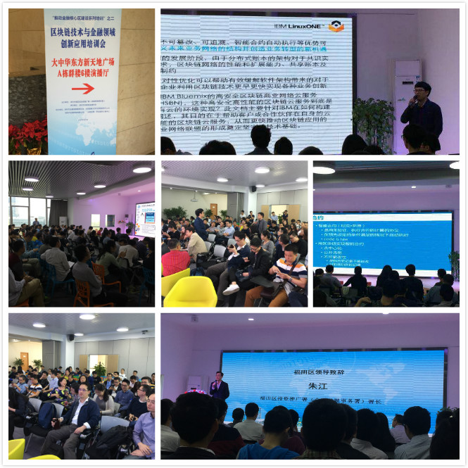
Our Meetups Before…
2016.12.25 Beijing
2017.1.7 Shenzhen

Slide 4

Hyperledger Hackthon is Coming
http://szqy.ffan.com/hack/Hack/

Slide 5
Agenda
13:00 ~ 13:30 签到 & 开场
13:30 ~ 14:10 Blockchain技术与HyperLedger概览
14:10 ~ 14:20 HyperLedger中国黑客松announcement
14:20 ~ 15:10 HyperLedger Fabric 1.0
15:10 ~ 15:30 Tea Break
15:30 ~ 16:30 企业应用实战
16:30 ~ 17:00 Round Table——The Future of HyperLedger and Q&A
17:00 ~ 18:30 Bluemix & Bluemix HyperLedger Services Training

Slide 6
Our Events Info…
meetup
https://www.meetup.com/Hyperledger-Shanghai/
活动行
http://www.huodongxing.com/event/1375786308500
微课堂
http://www.huodongxing.com/event/7375469419000
IBM微信公众号
ibmcloud

